Slide 1

Programing Microcontrollers
Kiot Innovations

Slide 2
MCU Specs
Flash
Ram
Speed
Voltages
Currents
Interfaces

Slide 3
GPIOs
Pin Numbers
Input
Analog and Digital Signal
Examples - Button, Sensor value
Output
Analog and Digital Signal
Examples - Led, Motor

Slide 4
Firmware
What is firmware ?
Firmware is software that's embedded in a piece of hardware. You can think of firmware simply as "software for hardware." However, it's not an interchangeable term for software.
Devices that you might think of as strictly hardware such as an optical drive, network card, TV remote, router, camera, or scanner all have software that's programmed into a special memory contained in the hardware itself.

Slide 5
FIRMWARE
How do we build it ?
How do we upload it ?

Slide 6


Slide 7
IDE
Board Selection
Board configuration
Board Addition
Port selection
Compiling code
Uploading code
Notes:
Show using Arduino IDE.
What are boards ?

Slide 8
Arduino programs
What is a sketch
Program Structure
Basic Program - Hello Arduino
Arduino Inbuilt functions
Notes:
In program structure
setup, loop, no need of importing functions, auto imported

Slide 9
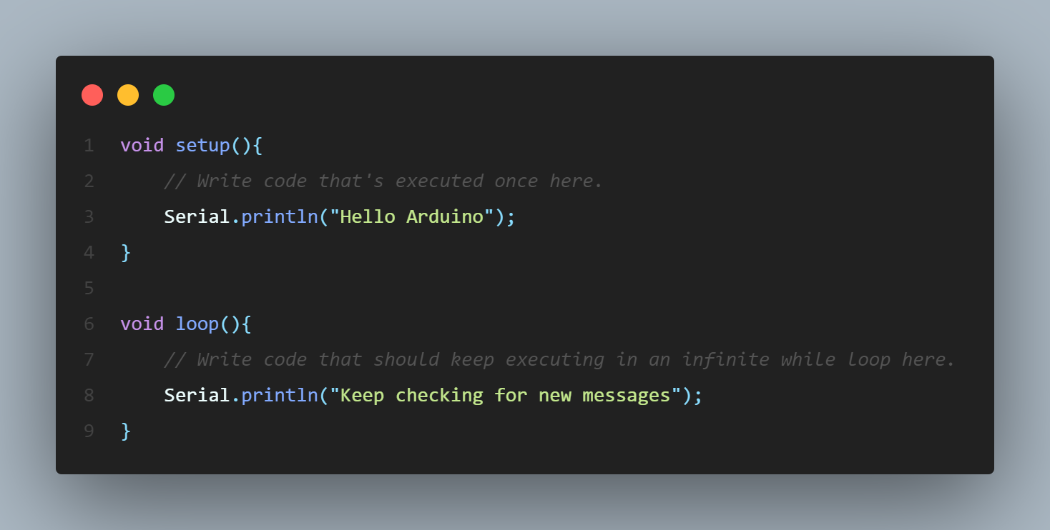
Basic Program structure

Slide 10
Arduino Inbuilt functions
GPIOs – pinMode, digitalRead, digitalWrite
delay, delayMicroSeconds, millis()
Simple program - blink example
Serial Monitor- printing/debugging
Notes:
Show serial monitor using the IDE

Slide 11
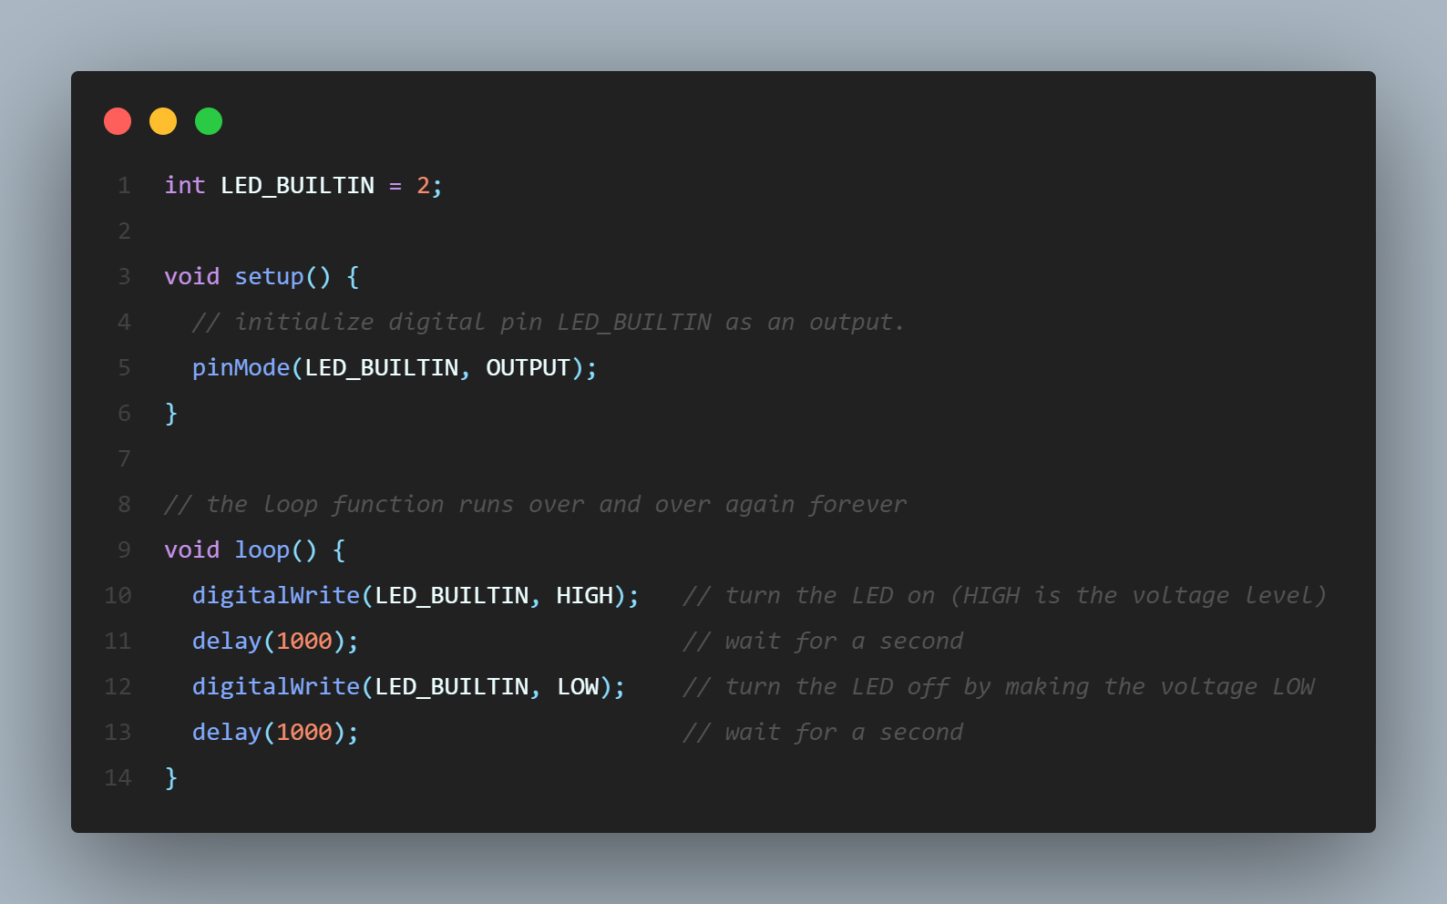
BLINK AN LED

Slide 12
Using Libraries and examples
Built in examples
How to add a new library
Library examples
Importing it
Notes:
Example - marvinroger/async-mqtt-client: 📶 An Arduino for ESP8266 asynchronous MQTT client implementation (github.com)

Slide 13
Questions ?

Slide 14
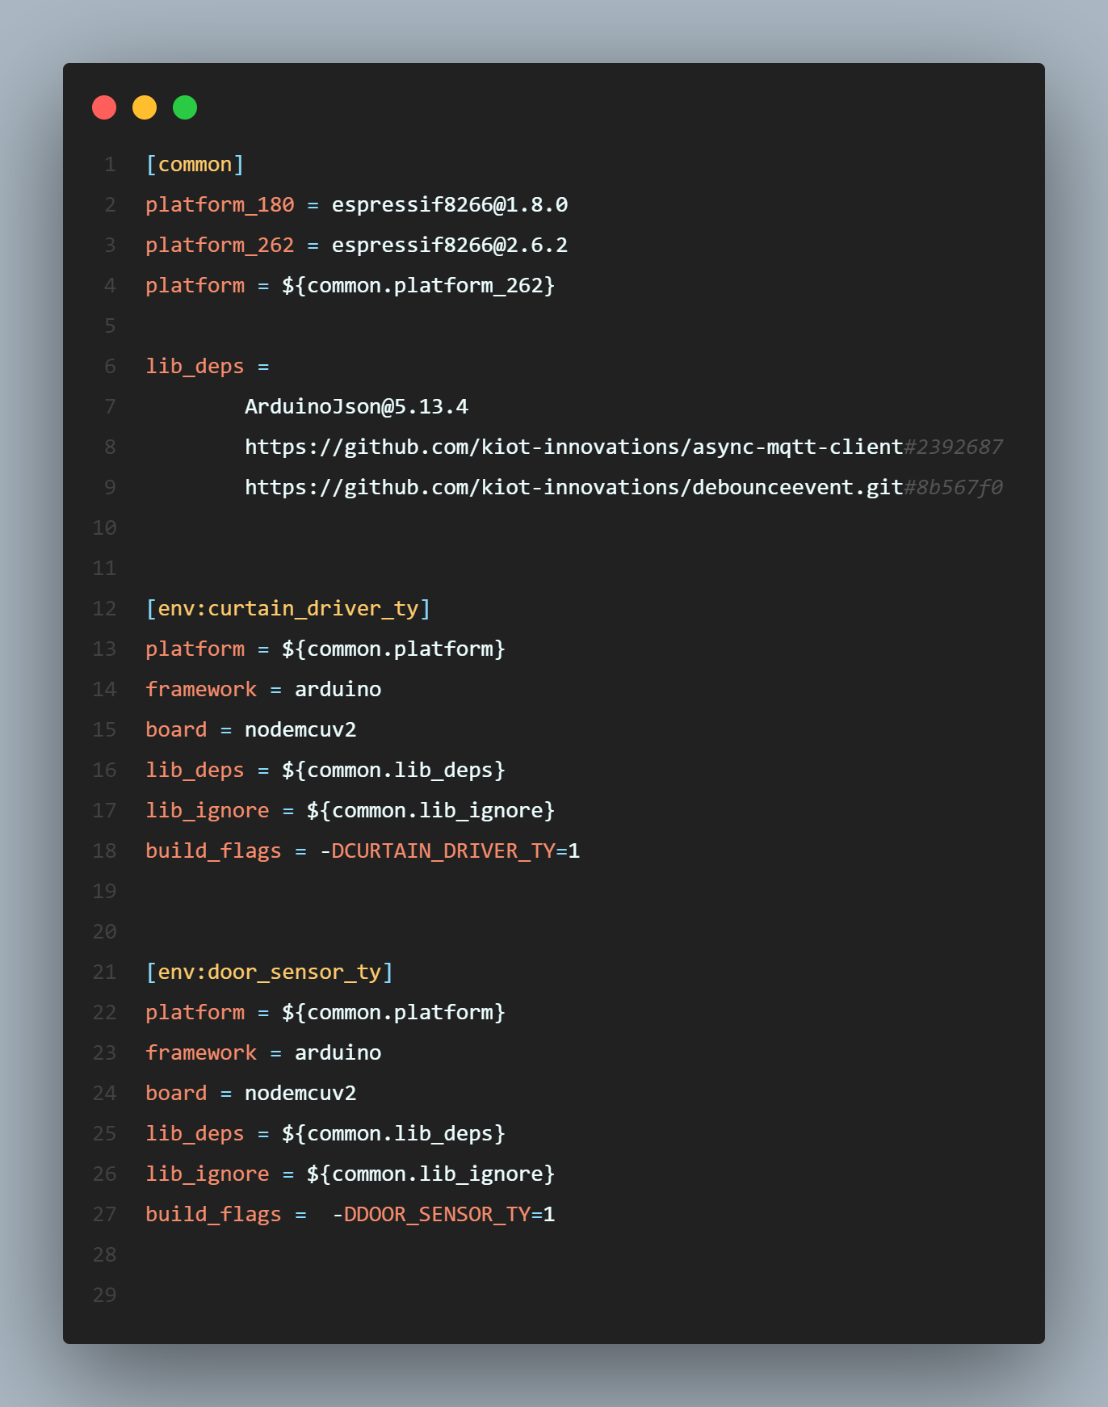
PLATFORMIO
Why we need it ?
Environments
Configurations
Debugging, Code analysing etc.
Notes:
PlatformIO allows developer to compile the same code with different development platforms using the Only One Command platformio run.
How we can use different environments, just by one line change we can compile against a new sdk version of espressif. How we can share libraries. Analogous to package.json
In, fact how we did it applications for partners was kind of inspired by platfromio.

Slide 15
Networking
For IOT DEVICES

Slide 16
Internet Structure
Not a topic of discussion today

Slide 17
Communication PROTOCOLS
Inter device communication protocols
Wired
Example – I2C, Serial (UART), Modbus etc
Wireless
Wifi
Bluetooth
Zigbee
ESP-NOW
Wifi Mesh
BLE Mesh
GSM/LTE
Lora & LoraWAN
Device to cloud communication protocols
Http
MQTT
Others
What are protocols ?
Standard way of talking or a communication language, mutually decided between two parties.
Notes:
Greeting example – If anyone wants to greet, they have to say Hello, It cannot say namaste, its not understood by ot
About the serial protocol – we’ll be discussing later

Slide 18
Why different protocols ?
Advantages & Disadvantages of every protocol
Suitable for different use cases

Slide 19
Comparison
WIFI
Bluetooth
Longer range
Connected directly to the cloud
Faster communication for high amount of data
Consumes less energy
Battery operated use cases possible
Good for frequent transmissions for less amount of data

Slide 20

WIFI

Slide 21
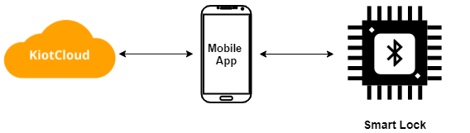
Bluetooth

Slide 22
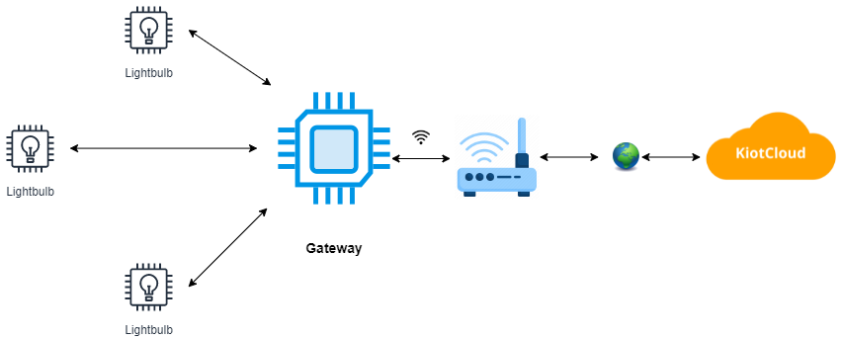
ESP-NOW (Star topology)
Notes:
Limitations
Bound to the range of gateway
If gateway is down, no devices can communicate with each other or the cloud.

Slide 23
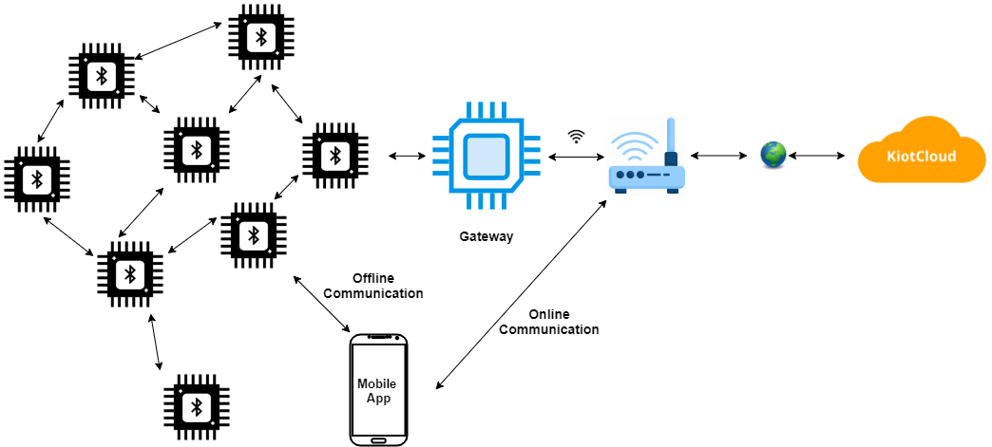
Bluetooth Mesh
Notes:
Advantages Lighting products
High number of devices in commercial buildings
Smart home products for large homes
Battery powered sensors
On premise control without internet or wifi
Zigbee Mesh
Why not Wifi Mesh ? How they do it - Managed Flooding

Slide 24
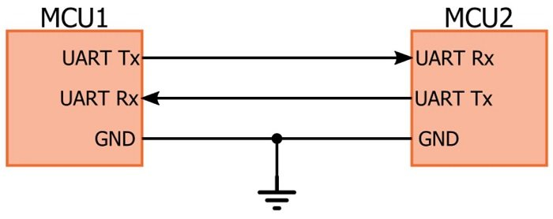
Wired communication
Why ?
Very Faster data communication needed (sum millisecond latency) – Sensor reading
Sharing Hardware design
When to use multiple MCUs in a hardware ?
When 1 mcu is good at a particular thing.
Example - Atmega328p has abundant GPIOs
Example – BLE Mesh – Telink Chip and esp8266 wifi chip
Serial (UART)
Baudrate (9600, 115200 etc)
Easy to use

Slide 25
C++ for JavaScript developers
Programming using C/C++ in Arduino

Slide 26
Compiling
C++ is compiled. JavaScript is not(In general)
Compile time safety
More effort during development but Optimized use of resources
Compilers and toolchains for different hardware architecture.
Apple C++, Intel C++, GCC etc

Slide 27


Slide 28
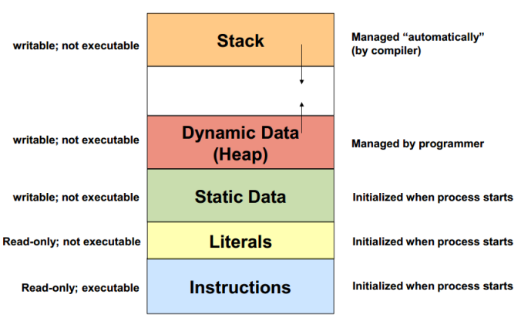
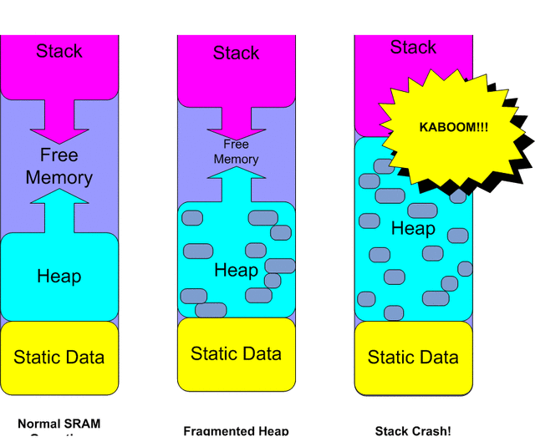
Memory Partition

Slide 29
Primitive types
Bool
Char
Int
Float
long
Unsigned int
Etc.
Uint8_t
Uint16_t
Uint32_t
Uint64_t
Ariane 5 Explosion | A Very Costly Coding Error - YouTube

Slide 30
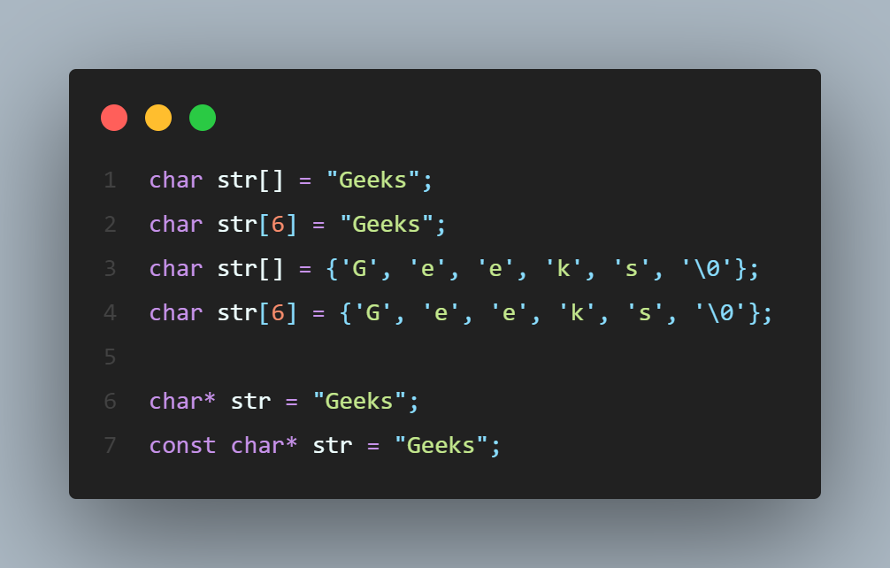
Strings

Slide 31
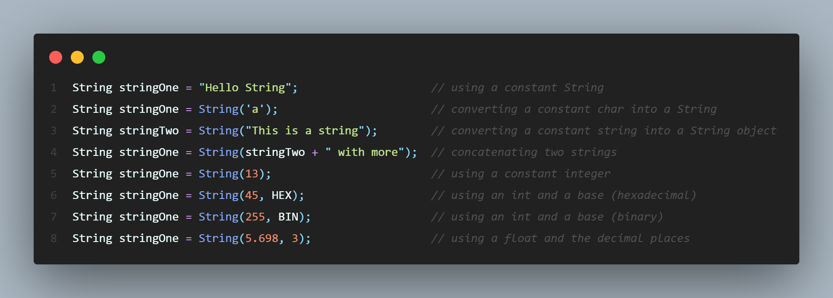
Arduino string class
BUILT IN METHODS
.equals()
.startswith()
.endsWith()
.substring()
.length()
.replace()
.toInt()
.toFloat()
.c_str()
etc
Easy to use
Less memory efficient, allocates in dynamic memory
All these can be implemented using standard c++.

Slide 32
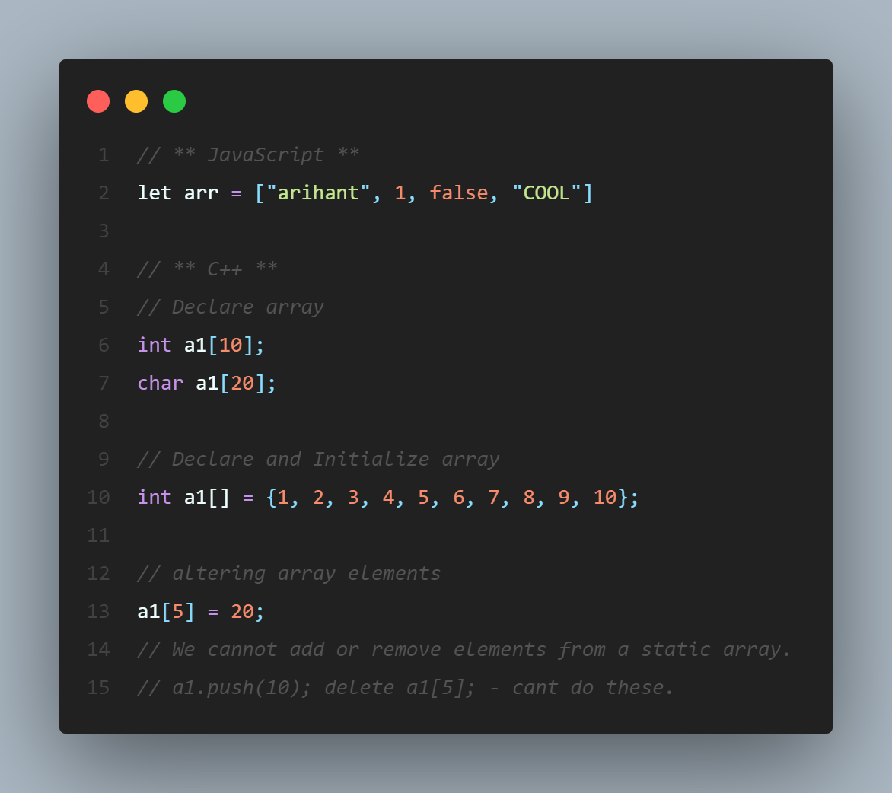
ARRAYS
Fixed Length Array Fixed size, Cannot modify once declared
Dynamic Arrays
Dynamic array Initialization
Vectors
We also have multi dimensional arrays.
There are other ways to have dynamic length arrays also. Not today’s scope.
Notes:
Alternate Dynamic array int *arr = new int(n);

Slide 33
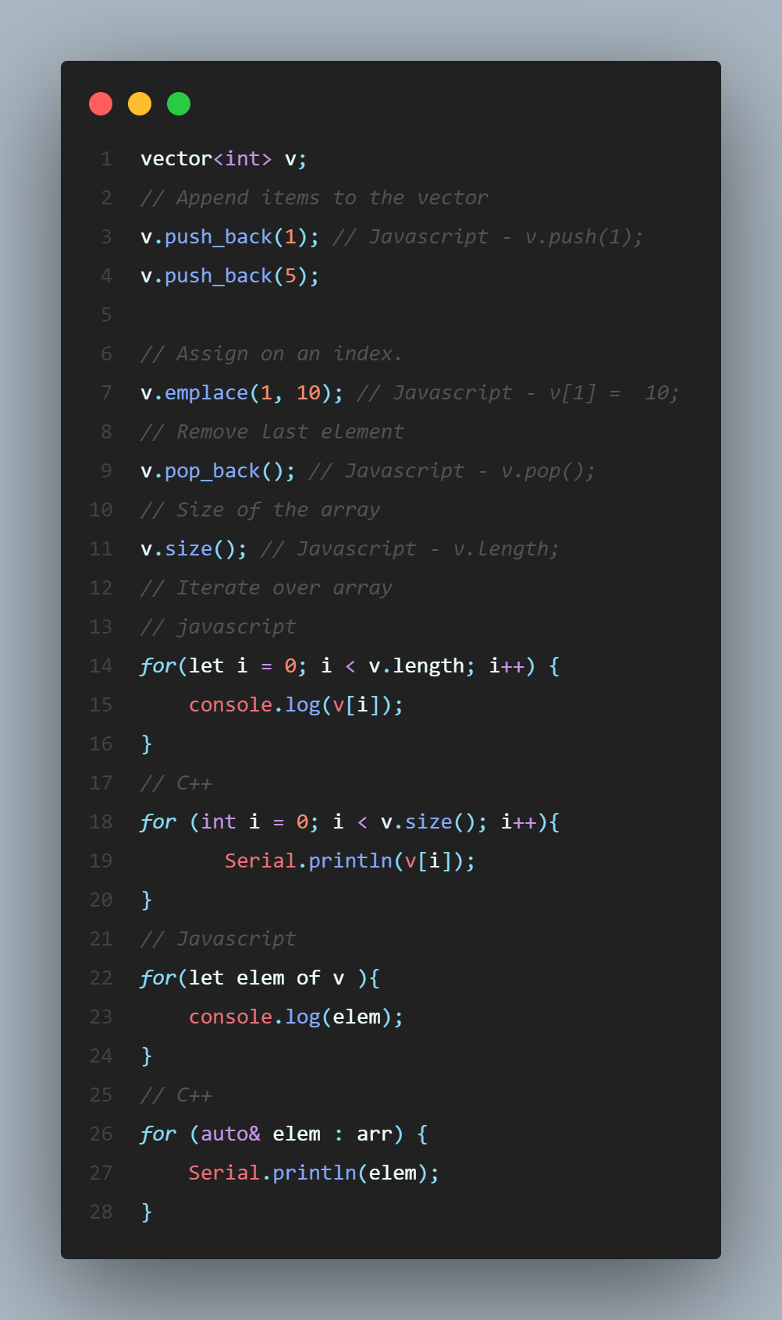
ARRAY Operations (With Vectors)
Assign items
Modify item
Iterate over array

Slide 34
Other vector methods
.erase()
.clear()
.resize()
.begin()
.end()
Etc
Vector in C++ STL – GeeksforGeeks

Slide 35
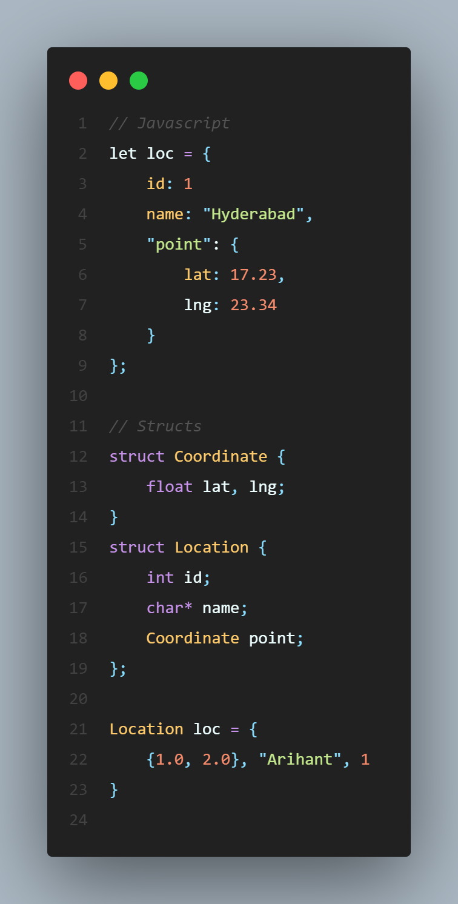
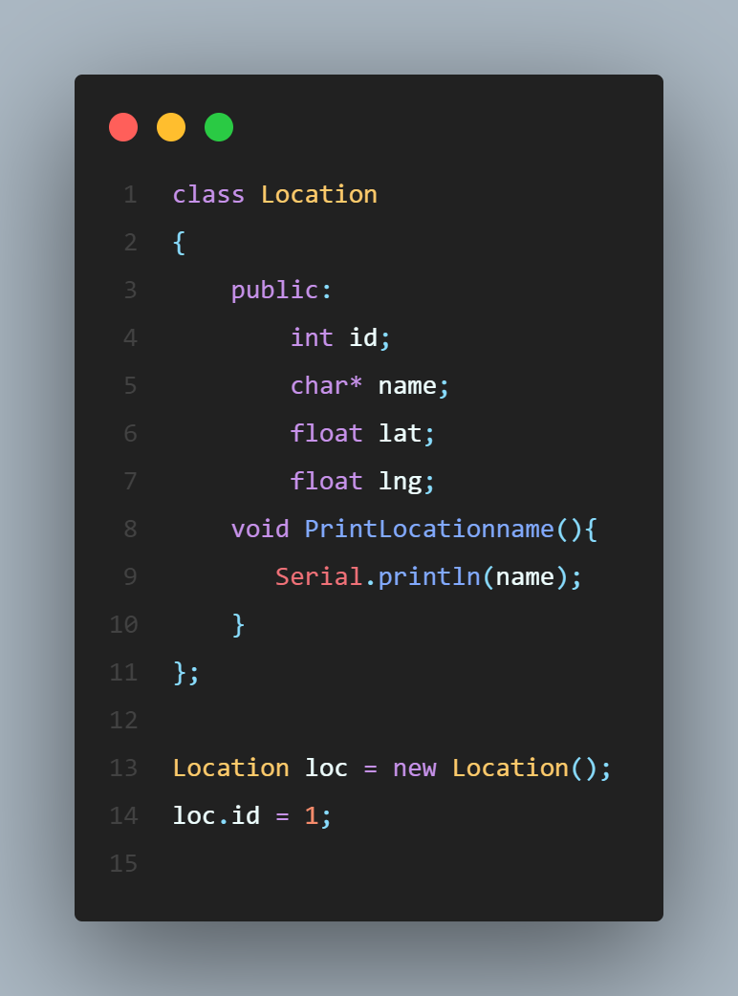
Objects/Dictionaries
Struct
Class
OOP - Encapsulation, Abstraction, Inheritance, Polymorphism
Learn more on Intro to Object Oriented Programming - Crash Course - YouTube)
Notes:
Maps

Slide 36
Printing

Slide 37
Control Structure
For loop, while loop
If else If, Switch cases

Slide 38
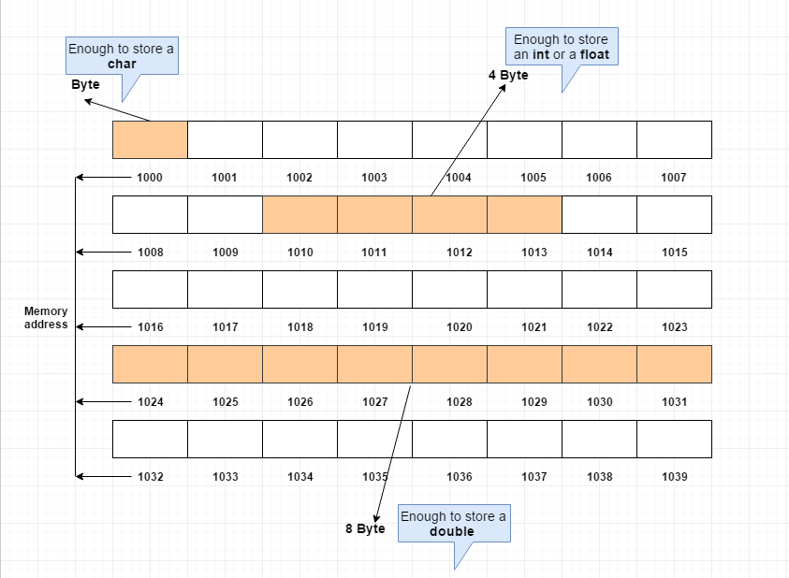
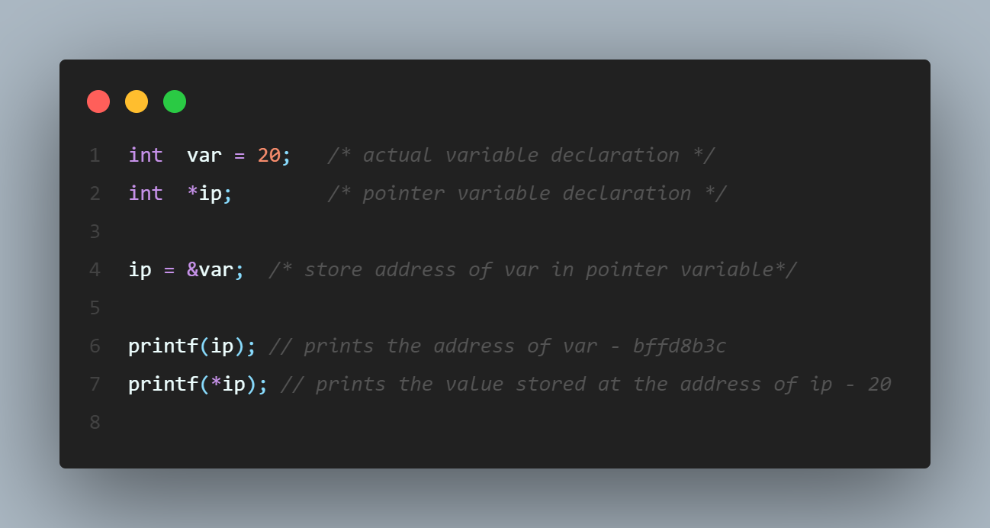
POINTERS
A pointer is a variable whose value is the address of another variable.

Slide 39
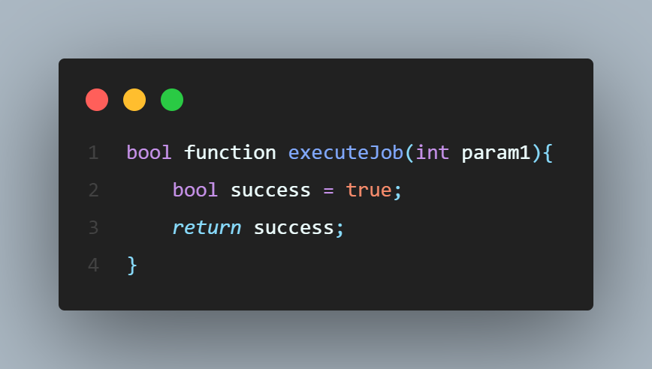
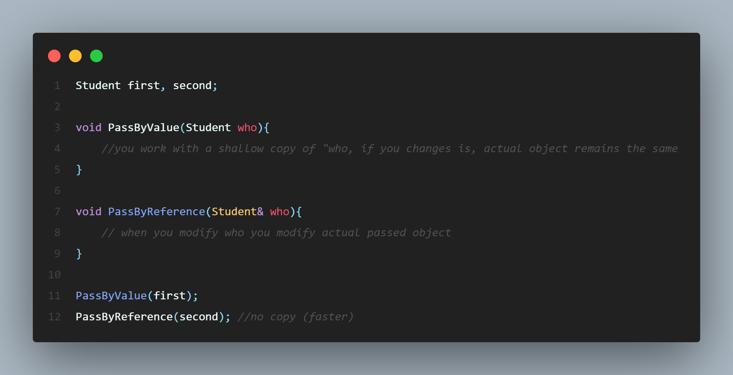
Functions
Arguments and return types are explicitly declared
Function flow remains almost same as JavaScript
Arguments can be passed either by value or by reference.
Passing arguments by reference is very common pattern
*passing by reference and passing by pointers (Passing by pointer Vs Passing by Reference)
Notes:
Javascript – its predefined – Arrays and Objects are passed as reference and string, int etc are passed by value.

Slide 40
Prototypes
Way to trick the compiler/ Tell that something will be available later, don’t panic right now.

Slide 41
Scope/Closures
Closures or scope of variables is very important, specially when dealing with arrays/strings.
Example - Making things catastrophic
ANOTHER DAY

Slide 42
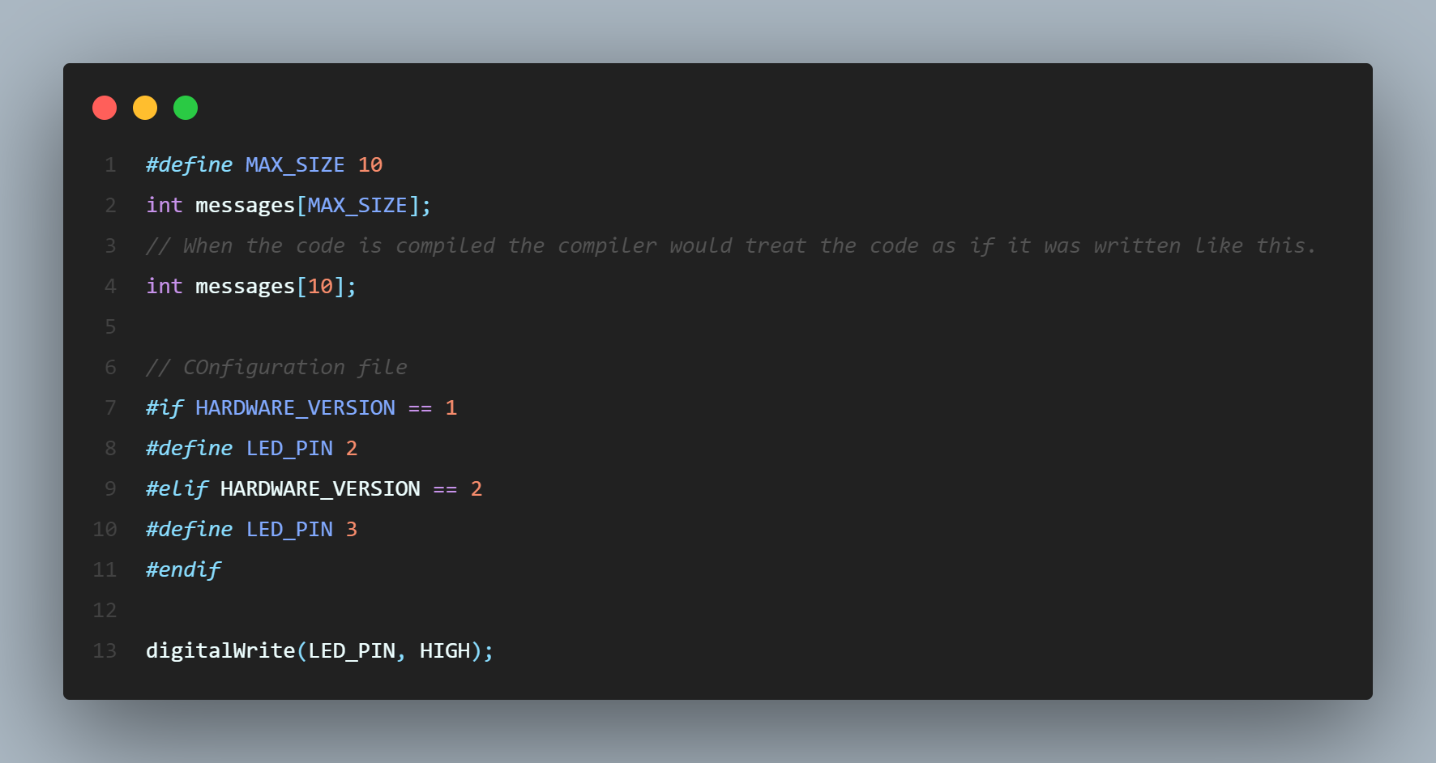
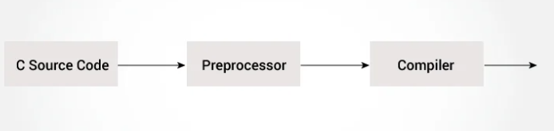
Macros/Preprocessors
The C preprocessor is a macro preprocessor (allows you to define macros) that transforms your program before it is compiled.
Benefit – Configurable environments
Do not consume memory
Supports control structure like if else.
Common usage - #define, #undef, #if, #else, #elif etc.

Slide 43
Dynamic memory handling
Malloc, Calloc
Memcpy
Using new keyword

Slide 44
COMMON Programming Examples
How to do that in Arduino/C++

Slide 45
ANOTHER DAY

Slide 46
MCUs @ KIOT
ANOTHER DAY
Atmega328
STM32
ESP8266
ESP32
Telink Chips

Slide 47
Where to learn more
C++ - YouTube playlist for learning C++ concepts

Slide 48
THANK YOU

